Slide 1
Verletlist on AMD Milan
Ashwin Varkey

Slide 2
Task
The task is to pick a CPU architecture and build and run MD-Bench for solid copper test case to perform runtime profiling, instruction code and performance analysis. Criteria for test case:
One specific compiler
Different SIMD vector lengths
SP and DP
Verletlist or Clusterpair
Compare full neighbor list vs half neighbor list

Slide 3
Test system
Host/Cluster name: Milan1
CPU name: AMD EPYC 7543 32-Core Processor
CPU type: AMD K19 (Zen3) architecture
CPU clock: 2.79 GHz (3.8 GHz Turbo)
Memory capacity:251.56 GB
Number of cores per node: 64
Interconnect:PCIe® 4.0 x128
Software Environment
Compiler: gcc/11.2.0 (gcc)
Tools:likwid/5.3.0 (for performance profiling and analysis)
Make Version: GNU Make 4.3

Slide 4
Testcase description
Force field: lj
Unit cells (nx, ny, nz): 32, 32, 32
Domain box sizes (x=y=z): 5.374708e+01
Data layout: AoS
Floating-point precision:DP/SP
Periodic (x, y, z): 1, 1, 1
Lattice size: 1.679596e+00
Epsilon: 1.000000e+00
Sigma: 1.000000e+00
Temperature: 1.440000e+00
RHO: 8.442000e-01
Mass: 1.000000e+00
Number of timesteps: 200
Reneighbor every (timesteps): 20
Sort atoms: no
Delta time (dt): 5.000000e-03
Cutoff radius: 2.500000e+00
Skin: 3.000000e-01
Half neighbor lists: 0 or 1 (for half)
Processor frequency (GHz): 3.1000

Slide 5
Build SOFTWARE
Begin by editing `config.mk`, which contains various configurations that determine how the code will be compiled and optimized. For our case the conditions are:
- TOOLCHAIN: GCC
- ISA:x86
- SIMD : NONE, SSE, AVX2
- OPT SCHEME Verlet List (VL)
- ENABLE LIKWID: True
- DATA TYPE: SP and DP
- DATA LAYOUT:AOS
- ENABLE OMP SIMD: True (for half neighbor list Optimization)
- COMPUTE STATS: True
salloc -t 01:00:00 --exclusive -w milan1 -c 64 -p work -c hwperf

Slide 6


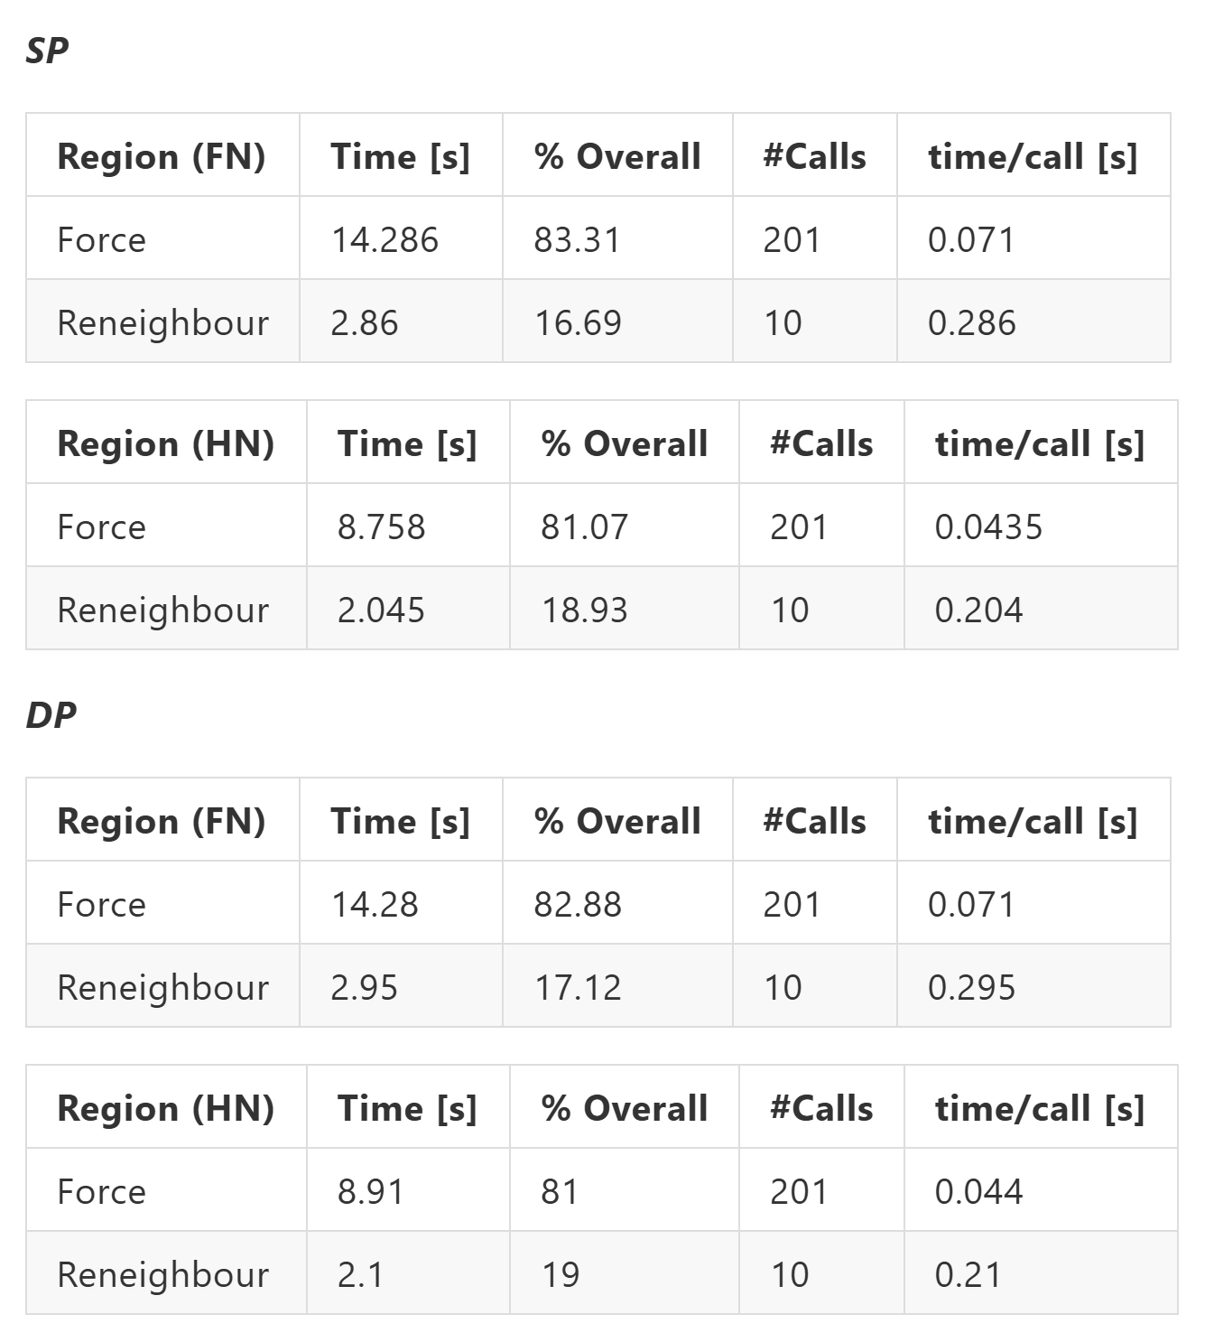
Runtime Profile
./MDBench-VL-GCC-X86-SP --freq 3.1
./MDBench-VL-GCC-X86-DP --freq 3.1 –half 1

Slide 7
Runtime Profile
Force region bottleneck: accounts for approximately 81-83% of runtime in both single (SP) and double precision (DP)
SP shows no performance improvement over DP in this analysis, despite expectations of better cache utilization
Half neighbor (HN) strategy advantage: scalar case improvement by reducing neighbor list update costs at each timestep

Slide 8
Instruction Count Analysis
This analysis aims to quantitatively characterize an application based on the number of executed instructions.
AMD Milan supports AVX2 (256 bit) but not the AVX-512 instructions.
AMD reports operations rather than instructions in some of their performance counters. On Zen4, there are specific "RETIRED_FP_OPS_BY WIDTH" and "RETIRED_PACKED_FP_OPS" events that directly track vector and scalar operations.
On Zen3, these events aren't available and RETIRED_MMX_FP_INSTR_SSE needed to be used

Slide 9
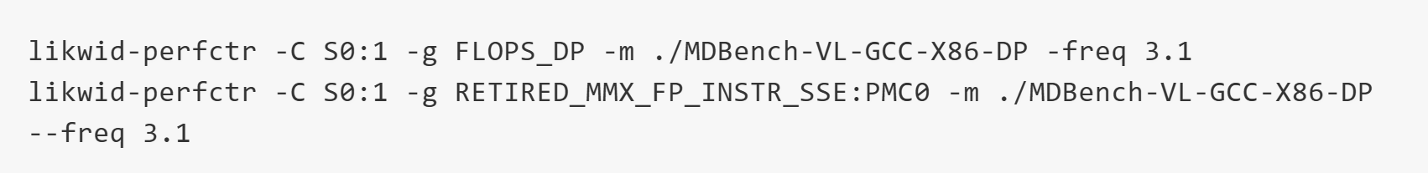
Approach 1
Use RETIRED_SSE_AVX_FLOPS_ALL to calculate Total Arith. Operations
Use RETIRED_MMX_FP_INSTR_SSE to measure flops performed using SSE instructions. (Arthimetic SIMD). SSE operations process either 2 double-precision (DP) or 4 single-precision (SP) values per 128-bit register.
AVX2 uses two SSE instructions per AVX instruction in Zen3 and is not natively supported
Calculate Arith. Scalar instructions by subtracting the 2 metrics :Total Arith. Instructions and Arith. SIMD operations
Arith. Scalar Ops= RETIRED_SSE_AVX_FLOPS_ALL- RETIRED_MMX_FP_INSTR_SSE/4 (SP)

Slide 10
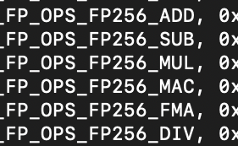
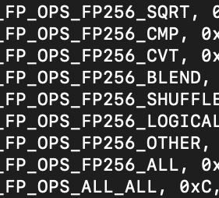
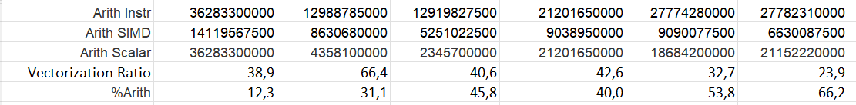
ISSUES
RETIRED_MMX_FP_INSTR_SSE aggregates all SSE instructions, not just arithmetic ones, potentially skewing analysis by including non-arithmetic operations like SHUFPS, BLENDPS, and MOVAPS.
It is also not possible to differentiate between AVX and SSE flops.
Using RETIRED_SSE_AVX_FLOPS_ALL to calculate total arithmetic operations (flops) and subtracting the SIMD ops does not give accurate scalar count, cross checked with INTEL Cascade Lake and AMD Genoa
Source: AMD Genoa
Source: AMD Milan

Slide 11
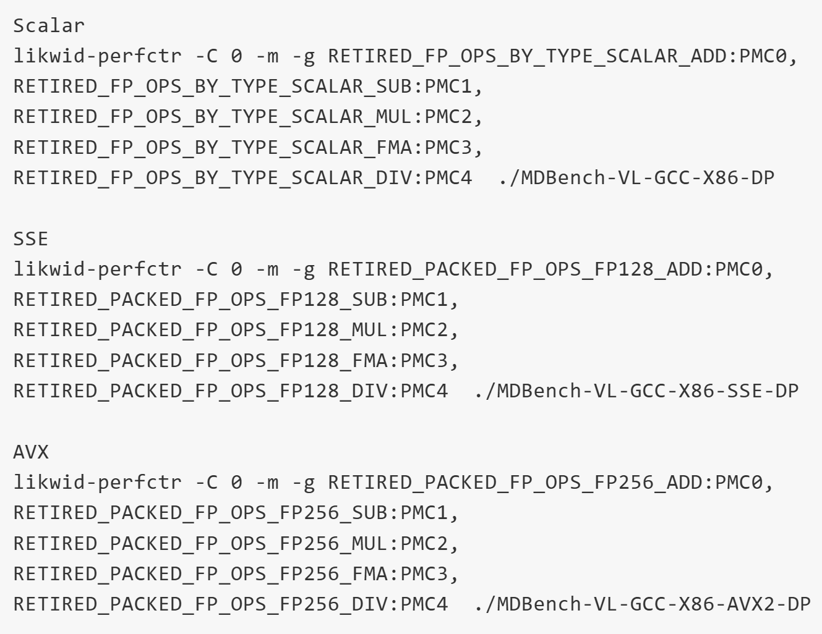
APPROACH 2
There are no other events to get accurate counts for arithmetic instructions by SIMD width and scalar in Zen 3
It was decided to take the values from Zen 4 architecture (AMD Genoa) which has better events like RETIRED_PACKED_FP_OPS which give separate counts for each SIMD and scalar operation.
RETIRED_PACKED_FP_OPS option tracks the retirement of packed floating-point operations on a specified CPU core for specific operations like ADD,SUB,MUL,DIV,FMA representing various floating-point arithmetic operations on different SIMD variants

Slide 12
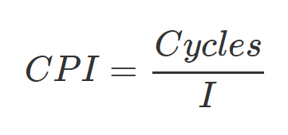
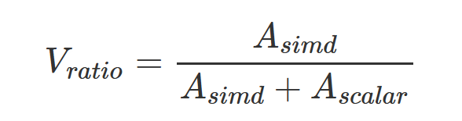
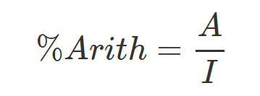
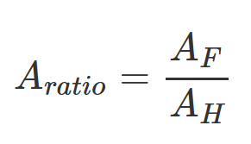
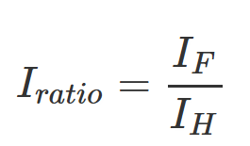
likwid-perfctr -C S0:1 -g FLOPS_SP -m ./MDBench-VL-GCC-X86-SP --freq 3.1 -half 1 likwid-perfctr -C S0:1 -g FLOPS_SP -m ./MDBench-VL-GCC-X86-SP --freq 3.1
SP | FN Scalar | FN SSE | FN AVX | HN Scalar | HN SSE | HN AVX
Total Ins. | 73458550000 | 41804010000 | 28181150000 | 53034620000 | 51656040000 | 41947810000
Time <s> | 13,72 | 4,33 | 3,37 | 8,73 | 9,12 | 8,82
CPI | 0,69 | 0,38 | 0,44 | 0,61 | 0,65 | 0,78
*Arith SIMD* | 0 | 12934640000 | 6301238230 | 0 | 2526909870 | 2526909870
*Arith Scalar* | 36283151000 | 217791974 | 460681670 | 21194487900 | 17659470800 | 14798639800
*Vectorization Ratio* | 0,0 | 98,3 | 93,2 | 0,0 | 12,5 | 14,6
*%Arith* | 49,4 | 31,5 | 24,0 | 40,0 | 39,1 | 41,3
Instr. FN vs Inst. HN | - | - | - | 1,39 | 0,81 | 0,67
Arith. FN vs Arith. HN | - | - | - | 1,71 | 0,65 | 0,39
Speed up Time | - | 3,2 | 4,1 | - | 1,0 | 1,0
Perf <MFlops/s> | 2643,3 | 11988,4 | 15332,2 | 2428,5 | 3045,2 | 3150,9
metrics marked with * prefix are taken from AMD Genoa
Table-Instruction Count Analysis -SP

Slide 13
likwid-perfctr -C S0:1 -g FLOPS_DP -m ./MDBench-VL-GCC-X86-DP --freq 3.1 -half 1 likwid-perfctr -C S0:1 -g FLOPS_DP -m ./MDBench-VL-GCC-X86-DP --freq 3.1
DP | FN Scalar | FN SSE | FN AVX | HN Scalar | HN SSE | HN AVX
Total Ins. | 73432270000 | 55602820000 | 32516670000 | 53034650000 | 53473780000 | 40784140000
Time <s> | 13,86 | 5,90 | 4,18 | 8,70 | 9,31 | 8,96
CPI | 0,70 | 0,3924 | 0,48 | 0,61 | 0,64 | 0,81
*Arith SIMD* | 0 | 21768150600 | 10474058150 | 0 | 2526910970 | 2526910970
*Arith Scalar* | 36283320000 | 592457550 | 460667170 | 21201667900 | 17666652900 | 14798646900
*Vectorization Ratio* | 0,0 | 97,4 | 95,8 | 0,0 | 12,5 | 14,6
*%Arith* | 49,41 | 40,21 | 33,63 | 39,98 | 37,76 | 42,48
Instr. FN vs Inst. HN | - | - | - | 1,38 | 1,04 | 0,80
Arith. FN vs Arith. HN | - | - | - | 1,71 | 1,11 | 0,63
Speed up Time | - | 2,4 | 3,3 | - | 0,9 | 1,0
Perf <MFlops/s> | 2617,6 | 7481,5 | 10642,4 | 2437,5 | 2441,1 | 2537,6
metrics marked with * prefix are taken from AMD Genoa
Table-Instruction Count Analysis -DP

Slide 14
Key Observations
Lower instruction counts and low CPI which is noted in case of both FN and HN systems.
Vectorization is efficient which can be seen from the speedup in runtime (3x in FN-SSE and 4x in FN-AVX) and lower CPI
HN shows lesser performance improvement in SIMD variants with lower vectorization ratio values and instruction efficiency ratios close to or below 1.
FN is a more efficient algorithm, leveraging SIMD for higher performance in parallelized SP/DP workloads
AVX vectorization offers optimal performance
(15332,2 MFlops in AVX-SP-FN and 10642,4 MFlops in AVX-DP-FN)
SOA layout improves performance but doesn’t address HN issues.
SP | FN Scalar | FN SSE | FN AVX | HN Scalar | HN SSE | HN AVX
Total Ins. | 73458550000 | 41804010000 | 28181150000 | 53034620000 | 51656040000 | 41947810000
Time <s> | 13,72 | 4,33 | 3,37 | 8,73 | 9,12 | 8,82
CPI | 0,69 | 0,38 | 0,44 | 0,61 | 0,65 | 0,78
*Vectorization Ratio* | 0,0 | 98,3 | 93,2 | 0,0 | 12,5 | 14,6
Instr. FN vs Inst. HN | - | - | - | 1,39 | 0,81 | 0,67
Perf <MFlops/s> | 2643,3 | 11988,4 | 15332,2 | 2428,5 | 3045,2 | 3150,9
DP | FN Scalar | FN SSE | FN AVX | HN Scalar | HN SSE | HN AVX
Total Ins. | 73432270000 | 55602820000 | 32516670000 | 53034650000 | 53473780000 | 40784140000
Time <s> | 13,86 | 5,90 | 4,18 | 8,70 | 9,31 | 8,96
CPI | 0,70 | 0,3924 | 0,48 | 0,61 | 0,64 | 0,81
*Vectorization Ratio* | 0,0 | 97,4 | 95,8 | 0,0 | 12,5 | 14,6
*%Arith* | 49,41 | 40,21 | 33,63 | 39,98 | 37,76 | 42,48
Instr. FN vs Inst. HN | - | - | - | 1,38 | 1,04 | 0,80
Arith. FN vs Arith. HN | - | - | - | 1,71 | 1,11 | 0,63
Speed up Time | - | 2,4 | 3,3 | - | 0,9 | 1,0
Perf <MFlops/s> | 2617,6 | 7481,5 | 10642,4 | 2437,5 | 2441,1 | 2537,6

Slide 15
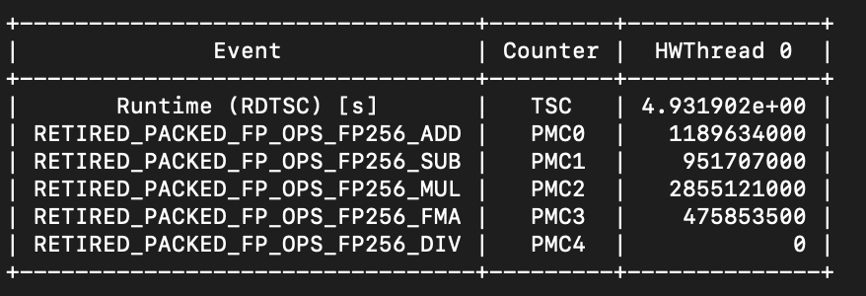
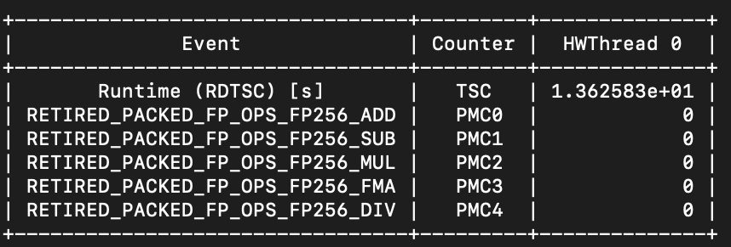
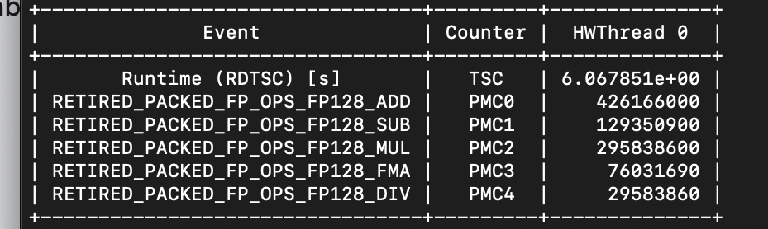
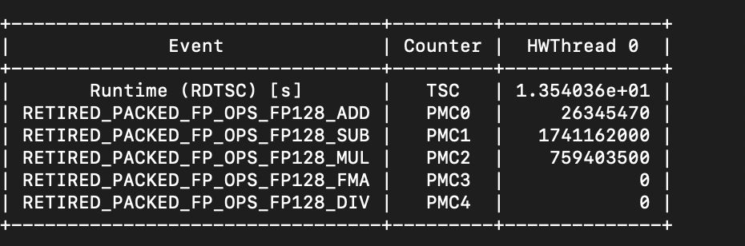
HN vs fN
AVX2-SP FN
AVX2-SP HN

Slide 16
Reasons
SIMD enables parallel execution by allowing a processor to apply the same operation to multiple data elements simultaneously. This reduces the number of instructions the CPU must process, improving efficiency by handling several data points at once.
Sparse datasets or skipped elements in HN lists lead to lowering SIMD efficiency.
Full list vectorization matches SIMD register width better, reducing overhead and improving performance
AVX2 gather instructions are better than SSE because they allow for the direct loading of non-contiguous data into vector registers, eliminating the need for multiple scalar loads and manual packing in case of scalar and SSE, which improves memory access

Slide 17
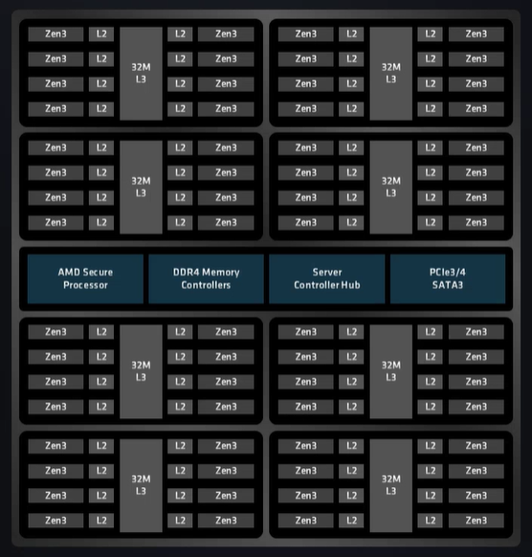
Performance Analysis
The AMD EPYC 7543 features a chiplet design with up to 8 cores per Core Complex Die (CCD) and shared L3 cache, along with a central I/O Die for memory and I/O connections.
The Milan series processors employ up to 64 7nm cores per processor, delivering 19% higher instructions per clock (IPC) compared to the previous-gen Rome processors.
The Zen 3 architecture redefines the CCD design, consolidating the L3 cache into a single 32MB shared cache for all cores on the same CCD, a significant upgrade from Zen 2, where each core had access to just 16MB of L3 cache
The CPU has 32 KB L1 cache, 512 KB L2 cache per core, and 32 MB L3 cache per CCD. It supports DDR4-3200 memory, 128 PCIe 4.0 lanes, and uses Infinity Fabric for high-speed interconnects.
Source: HPCWIRE

Slide 18
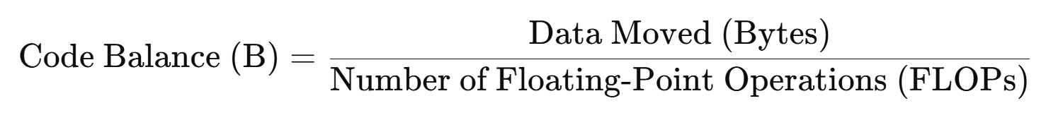
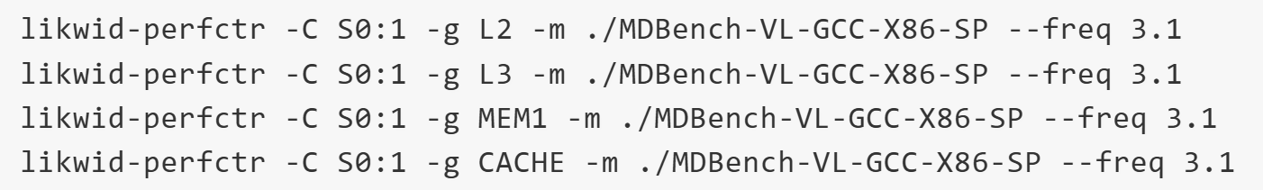
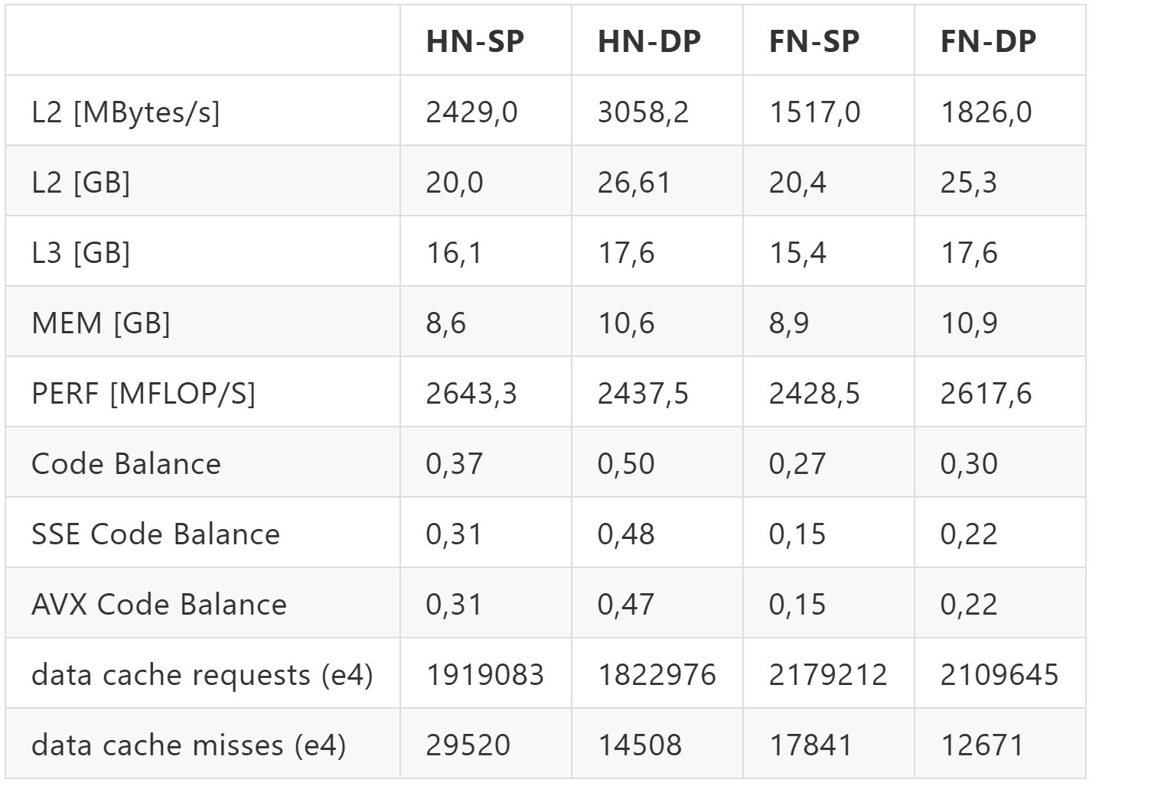

Slide 19
Key Observations
AMD Milan Architecture:
The victim cache temporarily stores evicted data, ensuring only modified data is written back to higher cache levels or memory, thus minimizing unnecessary transfers and improving system efficiency.
Data Flow:
10 GB of data comes from main memory
Data is reused twice in L2 cache around 20 GB
Kernel Performance:
Higher memory bandwidth in FN SIMD cases due to more data required for loading. Fits well in architecture
Single core memory bandwidth: 30-33 GB/s.
Peak performance: 39.2 GFLOPS (DP), 78.4 GFLOPS (SP).
Machine balance: 0.4-0.8, aligning with low code balance.
Cache Miss Behavior:
SP (Single Precision) experiences more cache misses than DP (Double Precision) despite the same cache accesses

